Slide 1
Transformer XL
Attentive Language Models Beyond a Fixed-Length Context
Presented by: Francisco Perez-Sorrosal

Slide 2
Motivation
Current SotA models are limited by fixed length context
BERT, Open-GPT...
Goal:
Break the limitation of fixed length input context in lang. models…
… without affecting temporal coherence
Results:
Capture longer-term dependencies in text
Solve the context-fragmentation problem
SotA results improved
Speed up increased over regular Transformers in evaluation (1800+ times faster)
Text generation with realistic “hallucinating” output
Applications on text generation, unsupervised feature learning, image??? and speech modeling

Slide 3
Intro
Recognizes the challenge of overcoming the problem of model LT dependencies in sequential data in neural models
LSTM Problem:
Gradient vanishing and explosion
Mitigation techniques (gradient clipping, better initialization, additional loss signal, augmented memory structure, rearchitecture) do not solve the problem completely
Advances when applying attention to direct connections between long-distance words pairs (Bahdanau 2014, Vaswani et al. 2017) ← “Attention is what you need” aka Transfomer paper
Advances in transformer networks for char-level language models (Al-Rfou et al. 2018)
Outperforms LSTM by a large margin
Caveats:
Based on selecting separated fixed segments of a bunch of chars
Selection, does not respect sentence/semantic boundaries
Consequence: Context Fragmentation → The model does not capture information flows across segments, leading to inefficient optimization and performance
Transformers have generally have better performance than RNNs, but are not the best for long-range dependency modeling due to fixed-length contexts

Slide 4
The Proposal: Transformer eXtra Large
Recurrence concept:
Idea: When applying self attention, reuse hidden states from previous segments
The reused hidden state, builds a connection between the segments
It serves as a memory for the current segment
Solves Context Fragmentation problem
Information is propagated in segments through the recurrent connection
Relative Positional Encodings
… instead of absolute ones...
… to avoid temporal confusion
Claim: Applying the previous two techniques above allows to achieve substantially better results than RNNs in char/word-level language modelings.

Slide 5
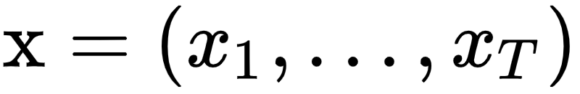
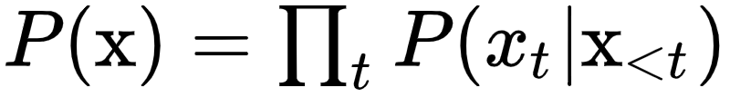
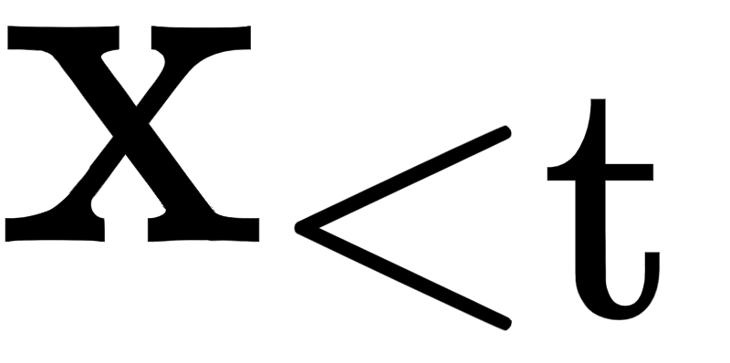
Model
Given a corpus of tokens:
Language model task:
Estimate the joint probability
Where is the context
In practice:
A neural network is trained to encode the context into a fixed size hidden state
Hidden state is multiplied by the word embeddings to obtain the logits
Logits are fed into a Softmax function
Result is the categorical probability distribution over the next token

Slide 6
Vanilla Transformers
Problem:
Train a transformer to convert an arbitrarily long context into a fixed size representation effectively
Naive approach
Process the entire context sequence and train an unconditional Transformer decoder similar to a FeedForward NN.
Impossible due to the limited resources (memory, proc)
Second approach (Vanilla transformers, Al-Rfou et al 2018)
At training, split the corpus in shorter segments of manageable sizes
Train the model in each segment
Self-attention is less affected by the vanishing gradient...
...BUT this ignores each contextual information from previous segments (no info flow)

Slide 7
Vanilla Transformers II
Limitations
The largest possible dependency length is limited by the segment length
… which is a few hundred chars in case of char-level LM
This means the model can’t refer to a word that appeared several sentences ago
Chunking text sequences into fixed-length segments leads to Context Fragmentation
In evaluation, each step:
Consumes a segment of same length as training
Makes a single prediction at the last position
Then the segment is shifted right one position
Relieves context fragmentation BUT...
… it’s very expensive

Slide 8
Segment Level Recurrence with State Reuse
Training
Compute a segment
Fix and cache the hidden state sequence computed
In the next segment take the previous segment hidden state and reuse it
This procedure:
Allows the gradient remain in the same segment
But the additional input allows the NN to exploit the history for modeling long term dependencies and avoid context fragmentation
Allows a speed increase: the elements in a new segment are processed all together without recomputation

Slide 9
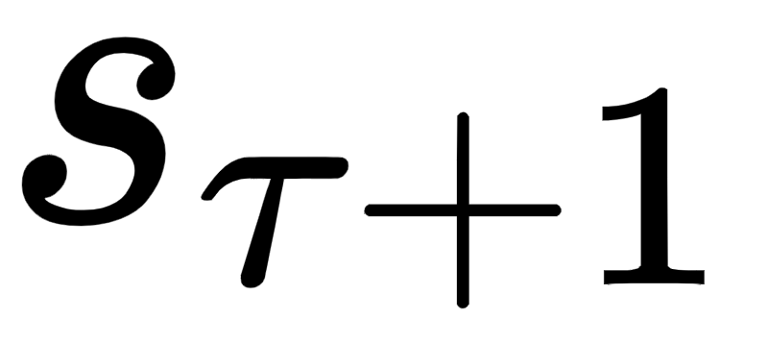

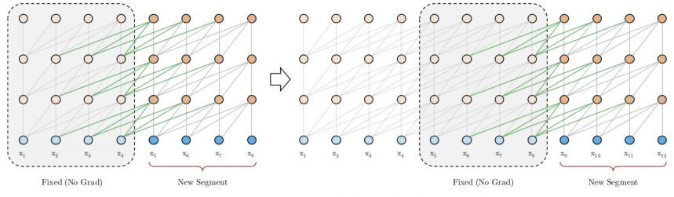
Segment Level Recurrence with State Reuse
query represents one word we want to predict, so we can’t modify the number of queries
n-th layer hidden state for segment :
Extended context
cached

Slide 10
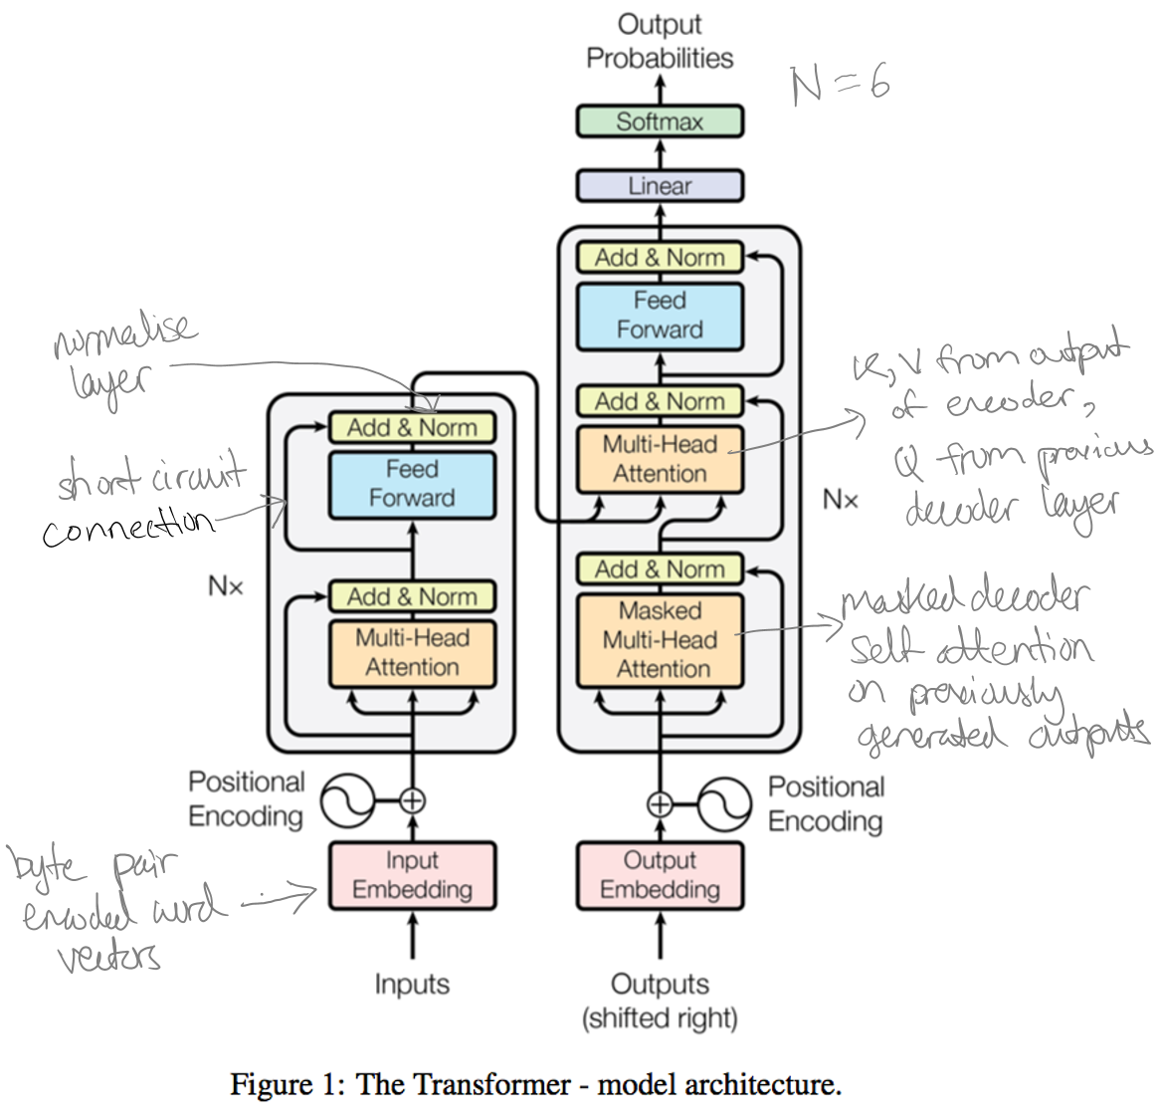
Transformer Architecture

Slide 11
Segment Level Recurrence with State Reuse
Segment-level recurrence in the hidden states → The effective context used moves beyond two segments

Slide 12
Segment Level Recurrence with State Reuse (Eval)
SLR means Faster evaluation over the Vanilla Transformer
The representations from previous segments are reused
More than one previous segment can be cached
In practice, M parameter -> old hidden states spanning (possibly) multiple segments:
Training → M = segment length
Eval → M is increased by multiple times
Refers to Memory-augmented Neural Networks (Graves et al 2014)
enwiki8 → Transformer-XL 1,800+ times faster than vanilla

Slide 13
Segment Level Recurrence with State Reuse (Eval)

Slide 14
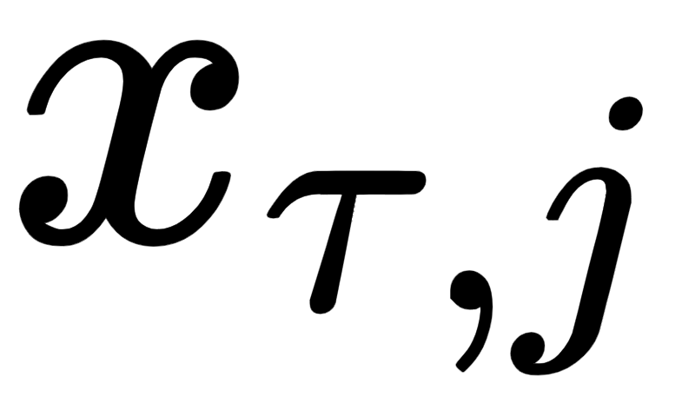
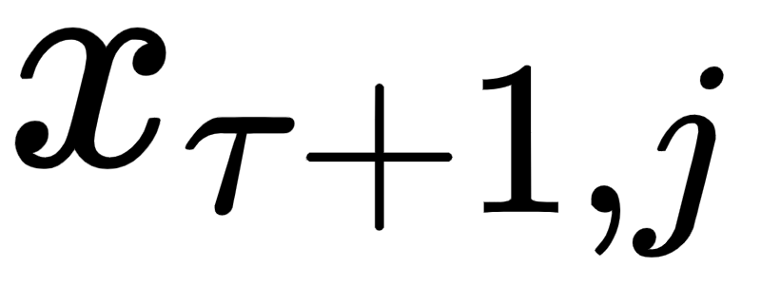
Relative Positional Encodings
Solve the question of how, while reusing the states, positional information is kept coherent
The positional encoding gives the model a temporal clue or “bias” about how information should be gathered, i.e., where to attend.
Traditional Transformers (Vaswani et al. 2017)
Sequence order maintained by positional encodings with absolute positions within a segment
Input = (word embeddings + positional encoding) element-wise
Simply adapting the positional embeddings to the recurrence mechanism does not work as the model has no information to distinguish the positional reference
and

Slide 15
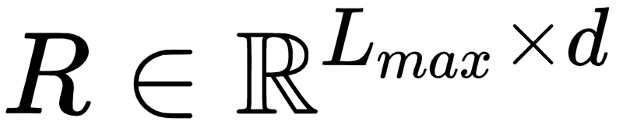
Relative Positional Encodings
Solution
Create a set of relative positional encodings
Lmax is the max seq length and d is the hidden dimension
Sinusoid encoding matrix with no parameters to learn
The i-th row indicates the relative distance between two positions
Injecting the relative distance in the attention score, the query vector can distinguish the representations of and from their distances
This allows:
Making the state reuse mechanism feasible
Avoid to lose any temporal information (the absolute position can be recovered recursively from relative distances)
Uses fixed embeddings with learnable transformations

Slide 16
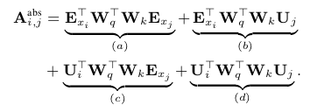
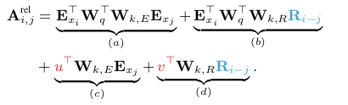
Relative Positional Encodings
Replace all appearances of the absolute positional embedding Uj with the relative one
In c) and d) add parameters u,v to replace the query UW. u is a learned vector that adjusts the importance of the other token content (Kj) v is another vector adjusts the importance based only on the distance between the tokens (previous word more important than far word)
Separate the two weight matrices Wk,E and Wk,R for producing the content-based key vectors and location-based key vectors respectively

Slide 17
Relative Positional Encodings
c) and d) Not present in Shawn et al. 2018
Each term has now a specific meaning:
represents content-based addressing
Capture close words, semantically similar to the target word
captures a content-dependent positional bias
governs a global content bias
Prior importance of each word regardless of the context
encodes a global positional bias

Slide 18
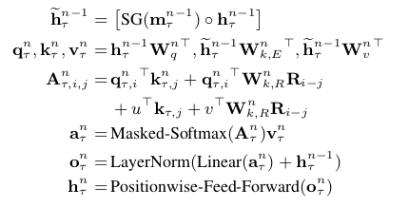
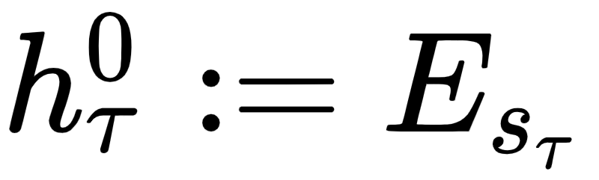
Transformer XL Architecture
For an N-layer architecture for n = 1,...N:
Where defined as the word embedding sequence

Slide 19
Results
5 Datasets
Wikitext-103 - Word-level, 28K docs, avg 3.6K tokens/doc → For long-term dep
Enwik8 - Char-level, 100M of unprocesed text
Text8 - Char-level 100M of processed text (a-z & _)
One Billion Word - Word-level, shuffled sentences → For short-term dep
Penn Treebank - Word-level, small (1M training tokens)

Slide 20
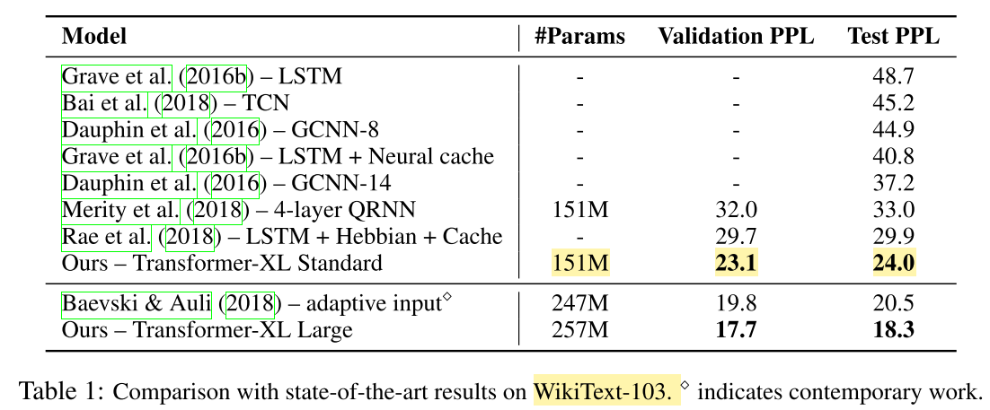
WikiText-103
Word-level, 28K docs, avg 3.6K tokens/doc → For long-term dep
Attention length = 384(train)/1600(eval)
Appendix D talks about 16, 10-head transformer layers, memory of 640
Config numbers not clear
Classical RNN Papers
Prev SotA

Slide 21
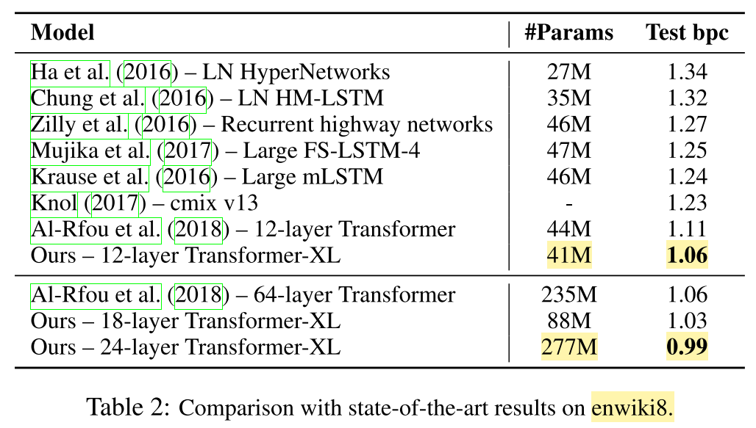
enwik8
Char-level, 100M of unprocessed text
Classical RNN Papers
Prev SotA
Prev SotA
Why?

Slide 22
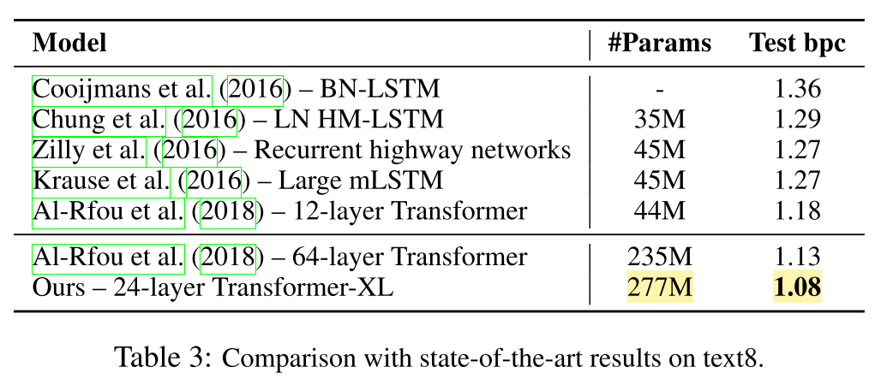
text8
Char-level 100M of processed text (a-z & _)
Classical RNN Papers
Prev SotA
Prev SotA

Slide 23
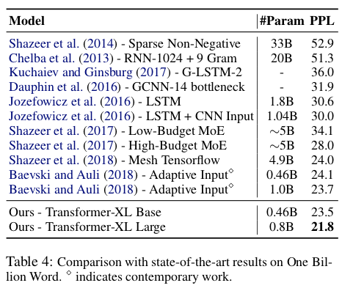
One Billion Word
Word-level, shuffled sentences → For short-term dep
Classical RNN Papers
Prev SotA
Prev SotA

Slide 24
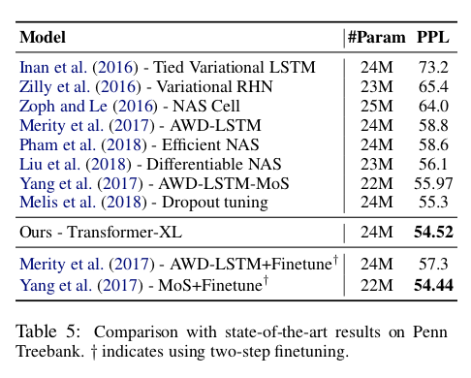
Penn TreeBank (PTB)
Word-level, small (1M training tokens)
Applying variational dropout and weight average
SotA results in small datasets without two-step fine-tuning

Slide 25
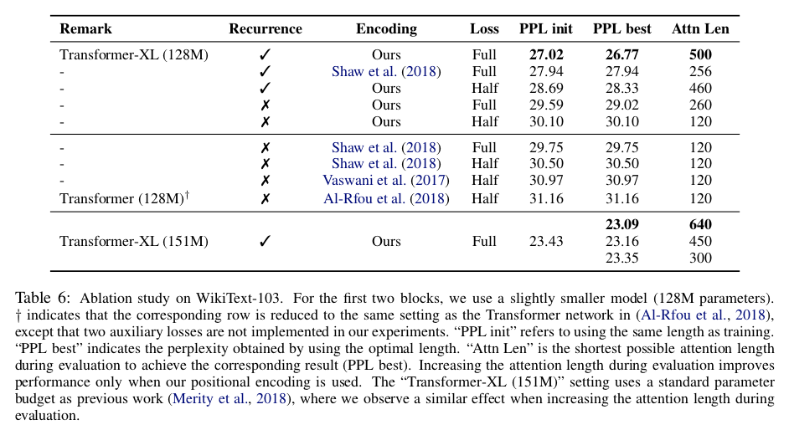
Ablation Study: (WikiText-103, word, long-term dep)
Att L=128
In Eval
Relative
Att Len in Training = 128
Rel
Abs
Abs
Abs
Att Len in Training = 128

Slide 26
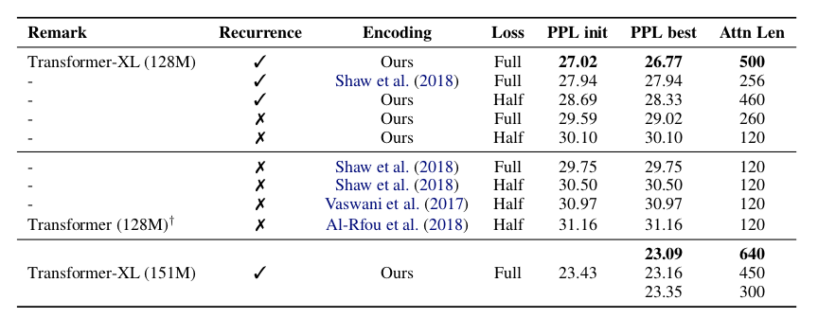
Ablation Study: (WikiText-103, word, long-term dep)
“Full” and “half”: applying cross entropy loss to all or the recent half positions in the segment
Absolute encodings only work well with half losses. Half losses exclude positions with very short att lengths in training for better generalization
In Eval
Att Len in Training = 128
Att Len in Training = 128

Slide 27
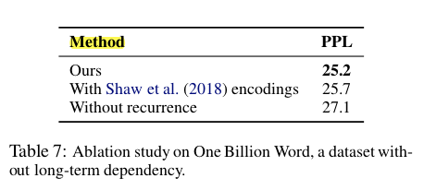
Ablation Study: Isolate Context Fragmentation Context Length
One Billion Word DS - Word-level, shuffled sentences → For short-term dep
20-layer Transformer-XL with ∼0.3B parameters for 400K steps
Redundant with the previous table??? I guess so… but different data here
With Recurrence
With Recurrence

Slide 28
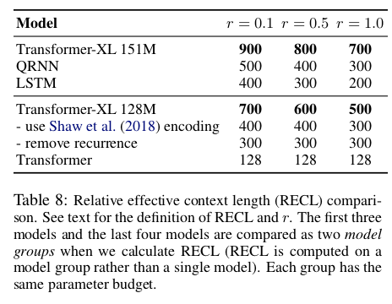
Evaluation: Relative Effective Context Length
ECL is the longest length to which increasing the context span would lead to a gain more than a threshold
Modification of Khandelwal et al. (2018) Effective Context Length (ECL)
Defined on a model group instead of a single model. Gain of a long context is measured by relative improvement over the best short context model
The model group shares the same baseline to enable fair comparison.
A parameter r, constrains the comparison on top-r hard examples
80% longer over QRNN on r=0.1
Reinforce the fact that Transformer XL can model longer-term dependencies
450% longer over transformer on r=0.1

Slide 29
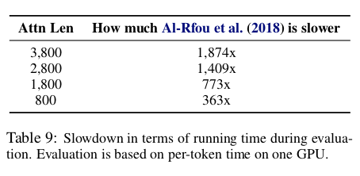
Evaluation: Speed
Vanilla Transformer (Absolute encoding)
Character level
Why not measure against Shawn et al. (2018)???

Slide 30
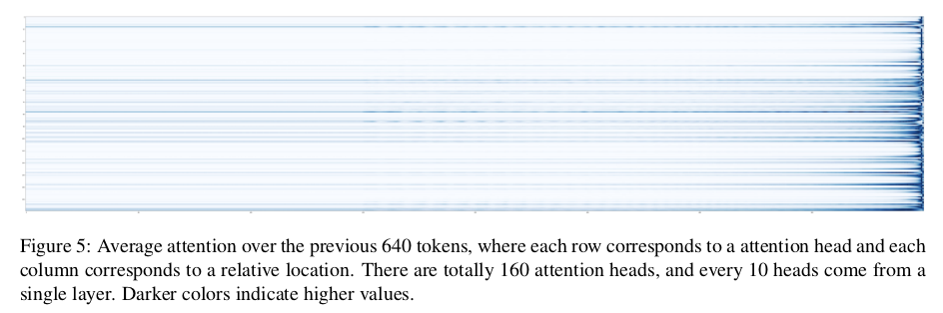
Attention Viz
1
8
16
16 layer with 10-head/layer transformer architecture = 160 att heads
You can see 3 layers with wide attention range

Slide 31
References
Original paper: https://arxiv.org/abs/1901.02860
Google AI Blog Presentation: https://ai.googleblog.com/2019/01/transformer-xl-unleashing-potential-of.html
A Light Introduction to Transformer-XL: https://medium.com/dair-ai/a-light-introduction-to-transformer-xl-be5737feb13
Transformer-XL – Combining Transformers and RNNs Into a State-of-the-art Language Model: https://www.lyrn.ai/2019/01/16/transformer-xl-sota-language-model/
Attention is All you need (Vaswani et al. 2017): https://arxiv.org/abs/1706.03762
Self-attention with relative position representations (Shawn et al 2018): https://arxiv.org/abs/1803.02155
https://arxiv.org/abs/1808.04444

